Slide 1
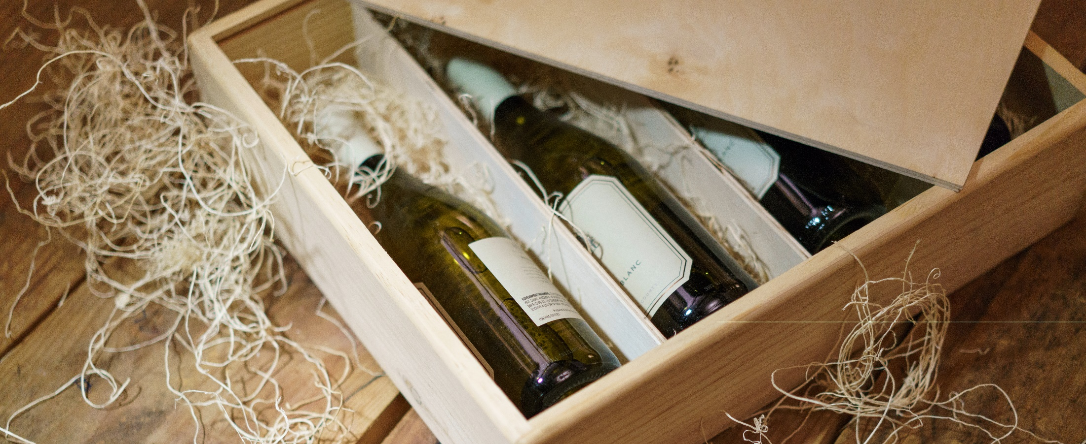
Wine, a matter of chemicals?
Group 2

Slide 2
Agenda
Application Area & Goals
Realted Work
Dataset
Approaches
kNN
Naive Bayes
Random Forest
Support Vector Machines
Feed-forward Neural Networks
Best results over all approaches
Discussion

Slide 3
Application Area & Goals
Predict quality of Vino Verde (red and white)
Only given the chemical values
Differentiate between good, avarage and bad wine
get an impression what attributes are important for red or white wine

Slide 4
Related Work
Well known dataset
For classification we should group the quality
Classes are inbalanced
Can lead to problems
So far the best results could be achieved with
Random Forest
SVMs

Slide 5
Dataset
1599 red wines
4898 white wines
11 different chemical attribute
Quality levels from 1 to 10 given by wine experts
Most wines quality 6
Notes:
Quality from red 3-8 and white 3-9

Slide 6
Dataset Decisions
Split of data into bad (<6) avarage (6) and good (>6) wines
Use RSME as success measurement
Skip generall prepocessing

Slide 7
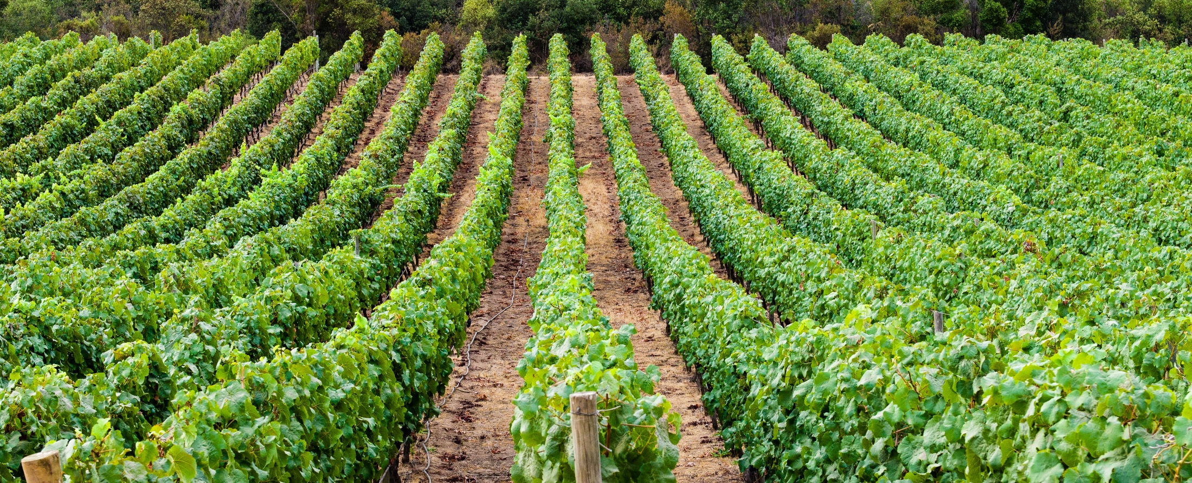
Different Approaches

Slide 8
kNN
Choose k = 1
Z-transformation
Really fast
RSME: 0.57 for white & 0.56 for red

Slide 9
Naive Bayes
Used Gaussian Naive Bayes due to continous attributes
Strong feature engineering
For red remains:
For white remains:
Really fast
RSME: 0.69 for white & 0.63 for red
Notes:
High correlated or unimportant attributes were removed

Slide 10
Random Forest
Due to bad performance use of Random Forest instead of Decsion Trees
No data normalization
Tree depth of 11
RSME: 0.54 for red and white
Notes:
Random Forest = multiple Decsion Tress put together in one big Decsion Tree

Slide 11
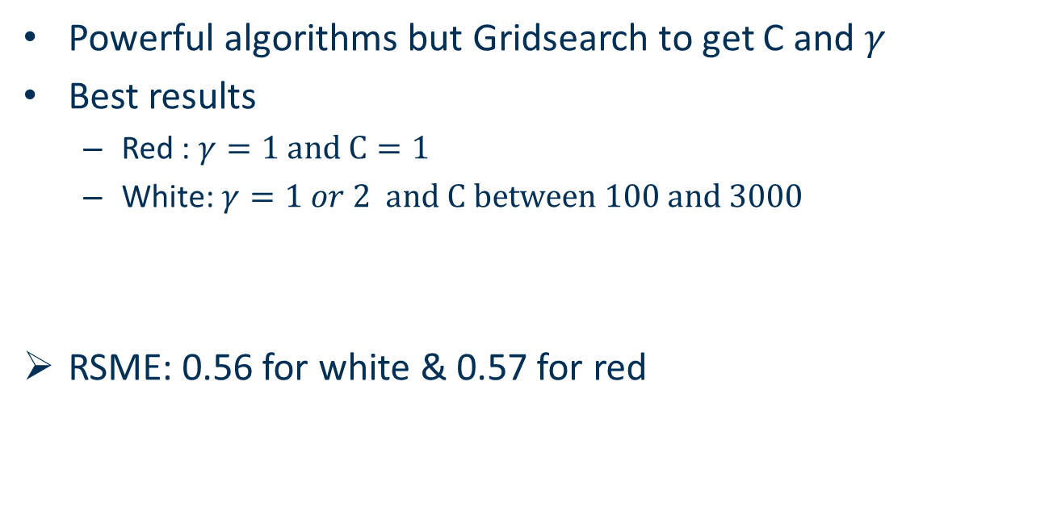
Support Vector Machines
Powerful algorithms but Gridsearch to get C and $γ$
Best results
Red : $γ=1 and C=1$
White: $γ=1 or 2 and C between 100 and 3000$
RSME: 0.56 for white & 0.57 for red

Slide 12
Feed-Forward Neural Networks
Use one Softmax Layer
Experiment with ReLU, eLU and SeLU Layers
SeLU with 8 nodes could give the best results
7 layers for white and 9 layers for red wine
RSME: 0.61 for white & 0.60 for red

Slide 13
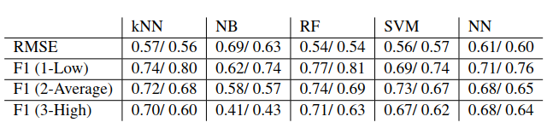
Best Results over all Approaches

Slide 14
Discussion
Radnom Forest achieved the best results
Due to robustness against data skewness
Hard to distinguish good and bad wine from average wine, but really good in distinguish bad from good wine

